Slide 1
AI Bias and Fairness & AI in Law and Regulations
General Applications of AI

Slide 2
Outline
AI Bias and Fairness
What Is AI Bias?
Defining Fairness
Bias Mitigation Techniques
Ethical Reflections
AI in Law & Regulations
Why AI Needs Regulation
EU AI Act Overview
India’s DPDP Act
Global AI Governance Trends

Slide 3
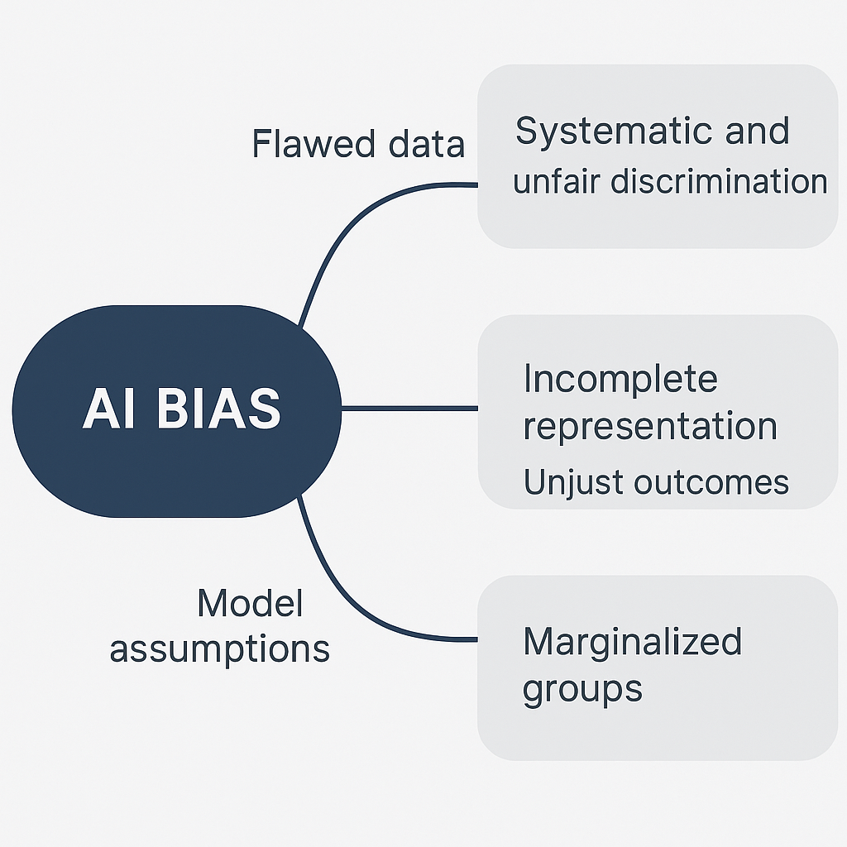
AI Bias and Fairness
What Is AI Bias?
AI Bias refers to systematic and unfair discrimination in the predictions or decisions made by an artificial intelligence system.
These biases often originate from flawed data, incomplete representation, or model assumptions and lead to unjust outcomes, especially against marginalized groups.

Slide 4
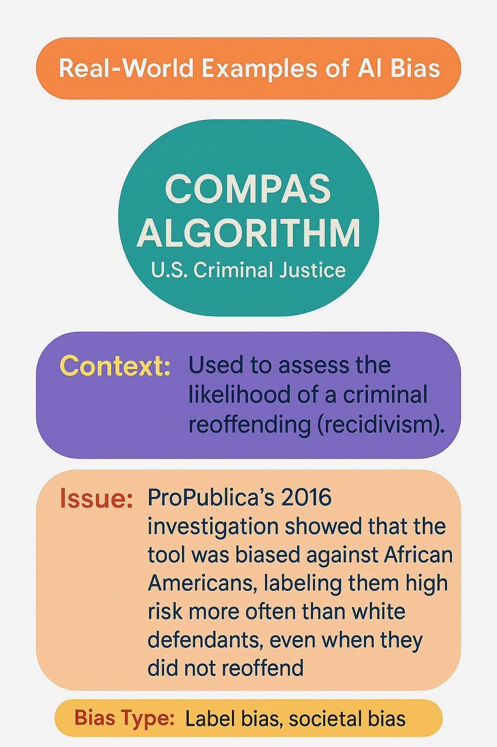
AI Bias and Fairness
Real-World Examples of AI Bias: COMPAS Algorithm (U.S. Criminal Justice)
Context: Used to assess the likelihood of a criminal reoffending (recidivism).
Issue: ProPublica’s 2016 investigation showed that the tool was biased against African Americans, labeling them high risk more often than white defendants, even when they did not reoffend.
Bias Type: Label bias, societal bias.

Slide 5
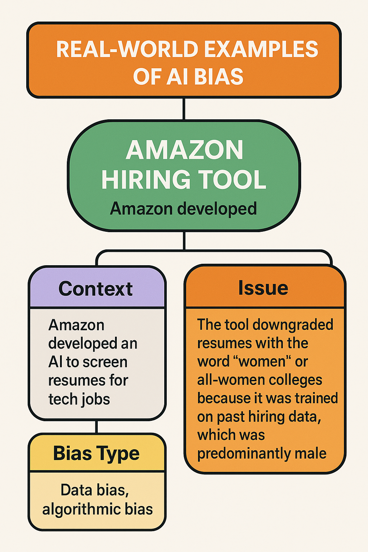
AI Bias and Fairness
Real-World Examples of AI Bias: Amazon Hiring Tool
Context: Amazon developed an AI to screen resumes for tech jobs.
Issue: The tool downgraded resumes with the word "women" or all-women colleges because it was trained on past hiring data, which was predominantly male.
Bias Type: Data bias, algorithmic bias.

Slide 6
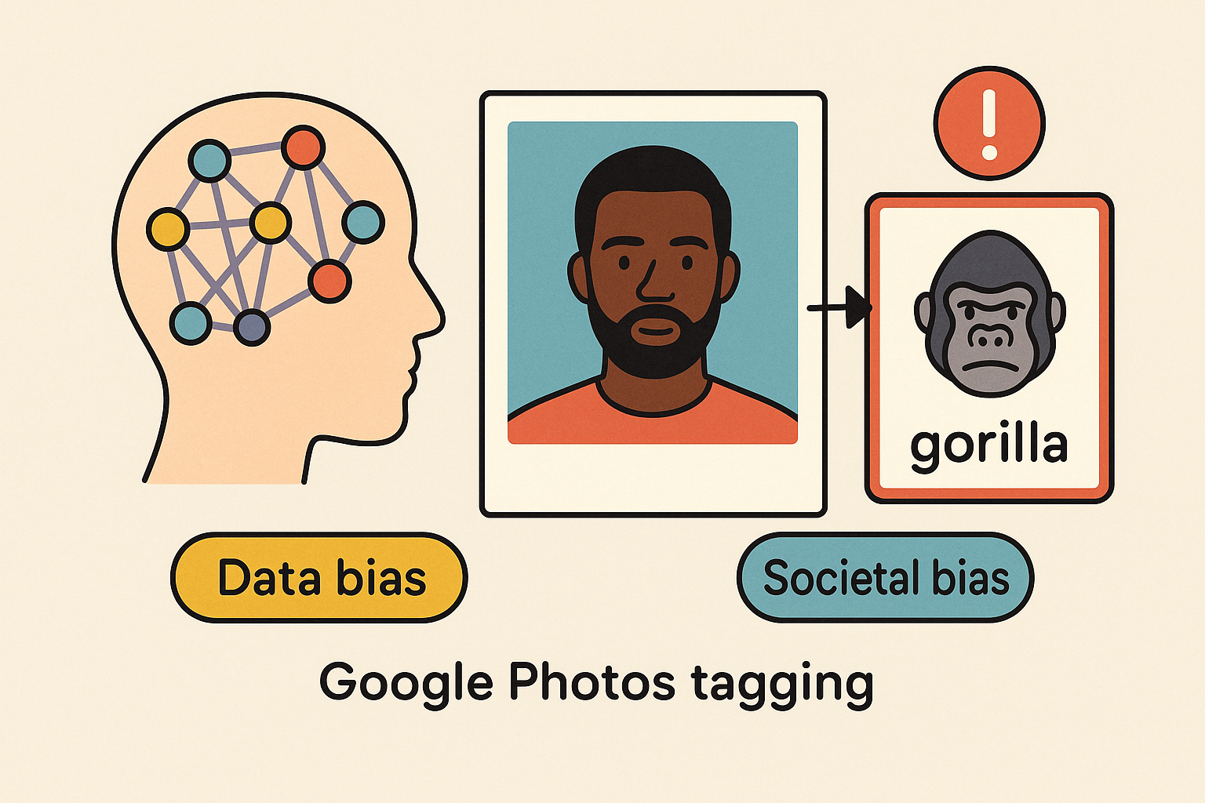
AI Bias and Fairness
Real-World Examples of AI Bias: Google Photos Tagging Incident
Context: Google's image classifier once tagged photos of Black individuals as "gorillas."
Issue: Poorly trained model due to underrepresentation of diverse faces.
Bias Type: Data bias, societal bias.

Slide 7
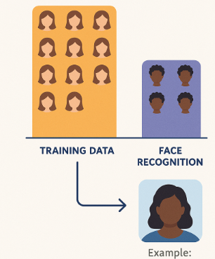
AI Bias and Fairness
Types of AI Bias: Data Bias
Occurs when the training data is not representative of the population the AI system will serve.
Example: Face recognition systems performing poorly on darker skin tones due to overrepresentation of lighter skin in training datasets

Slide 8
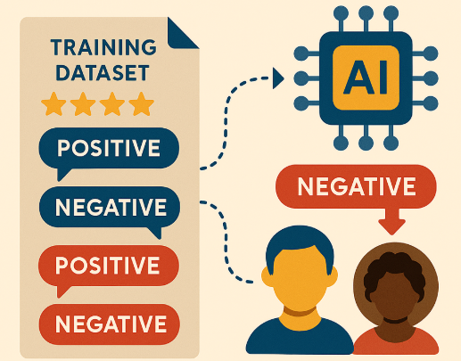
AI Bias and Fairness
Types of AI Bias: Label Bias
Happens when training labels (used for supervised learning) reflect human prejudices or errors.
Example: Social media sentiment models trained on user-reported data may classify tweets from minority groups as more negative due to past moderation practices.

Slide 9
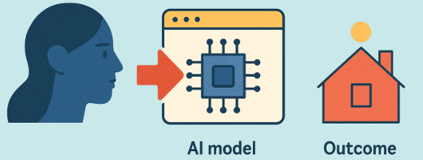
AI Bias and Fairness
Types of AI Bias: Algorithmic Bias
Introduced by model design choices — such as the choice of loss function, features, or training method — that systematically favor certain outcomes.
Example: A lending algorithm trained to minimize default rates may favor applicants from wealthier zip codes, encoding existing inequalities.

Slide 10
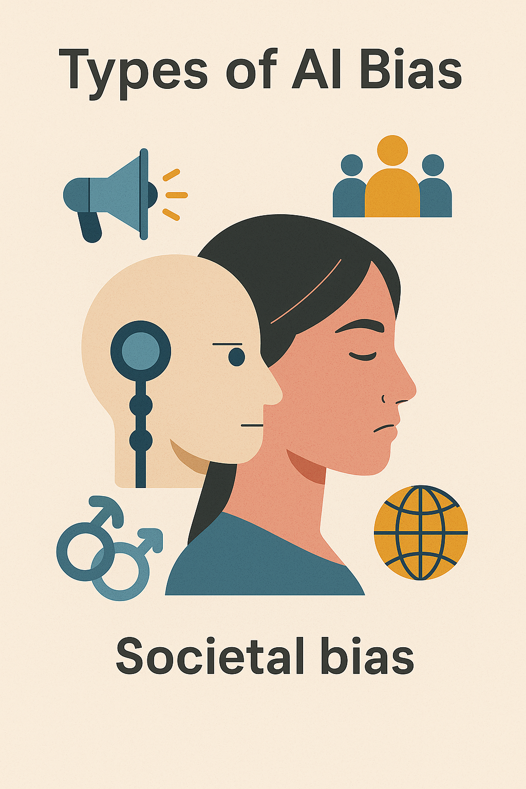
AI Bias and Fairness
Types of AI Bias: Societal Bias
Arises when AI models reflect structural inequalities and historic prejudices embedded in society.
Example: Language models generating biased or stereotypical outputs because of biased internet training data.

Slide 11
AI Bias and Fairness
Bias: Summary
Type of Bias | Source | Real Example
Data Bias | Unrepresentative training data | Facial recognition, Amazon AI
Label Bias | Prejudiced labeling practices | Sentiment analysis on tweets
Algorithmic Bias | Design of algorithm or objective | Biased scoring in hiring/lending
Societal Bias | Ingrained social inequality | Stereotypical content generation

Slide 12
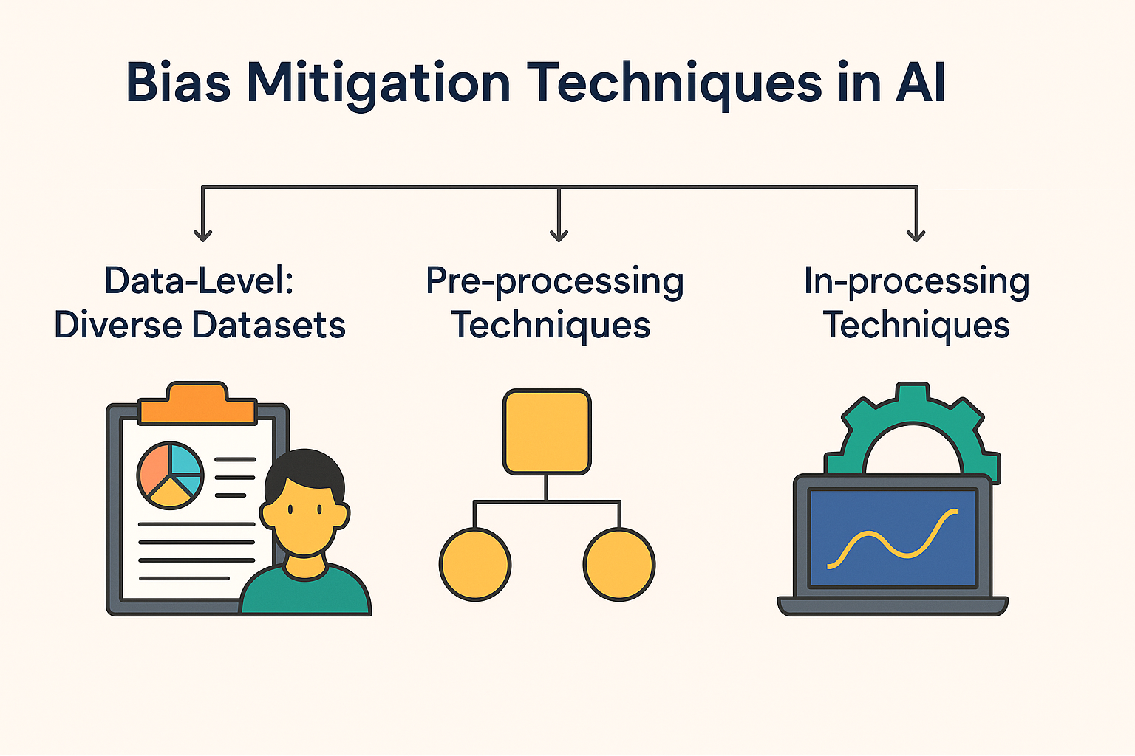
AI Bias and Fairness
Bias Mitigation Techniques in AI
Bias in AI can be mitigated at various stages of the machine learning pipeline. The three primary categories are:
Data-Level: Diverse Datasets
Pre-processing Techniques
In-processing Techniques

Slide 13
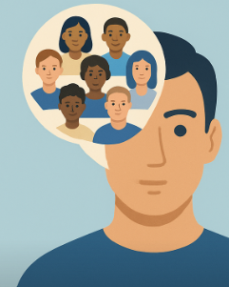
AI Bias and Fairness
Bias Mitigation Techniques in AI: Data-Level: Diverse Datasets
Reduce data bias by ensuring diverse and representative training data.
Approaches:
Balanced Sampling: Ensure proportional representation of all demographic groups.
Data Augmentation: Generate synthetic examples to boost minority group representation.
Bias Auditing Tools: Tools like IBM AI Fairness 360 and Fairlearn help identify imbalance in datasets.
Example: A facial recognition system trained on images from multiple age groups, genders, and ethnicities instead of just Western male faces.

Slide 14
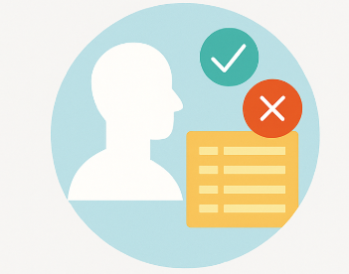
AI Bias and Fairness
Bias Mitigation Techniques in AI: Pre-processing Techniques: Modify the dataset before training to reduce bias.
a) Reweighting: Assign higher weights to underrepresented or disadvantaged groups to balance their influence during training. Tools like Reweighing algorithm in AIF360 can implement this.
b) Disparate Impact Remover: Edits features so that their statistical distributions are similar across groups.
c) Data Cleaning / Label Repair: Fix biased labels (e.g., in recidivism prediction) by human review or relabeling.
Example: Adjusting a loan approval dataset where women applicants are underrepresented by upsampling their examples or reweighing the loss function.

Slide 15
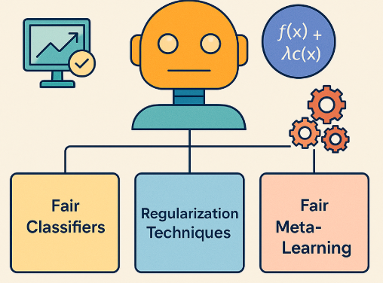
AI Bias and Fairness
Bias Mitigation Techniques in AI: In-processing Techniques
Modify the learning algorithm or model training process to reduce bias.
Fair Classifiers: Use algorithms designed to optimize both accuracy and fairness.
Example: Adversarial Debiasing, which trains a model to predict outcomes while simultaneously minimizing the ability to predict protected attributes (e.g., gender).
Regularization Techniques: Add fairness-related terms to the loss function (e.g., penalize demographic disparity).
Fair Meta-Learning: Meta-algorithms that adapt standard learners to enforce fairness constraints.
Example: Logistic regression with fairness constraints on false positive rates across groups.

Slide 16
AI Bias and Fairness
Bias Mitigation Techniques
Stage | Method | Tools / Examples | Notes
Data | Diverse Sampling | Manual balancing, SMOTE, Data audit tools | Prevents bias from entering
Pre-processing | Reweighting, Repair | AIF360 Reweighing, Disparate Impact Remover | Before model training
In-processing | Fair Classifiers | Adversarial Debiasing, Fair Logistic Regression | Modifies learning algorithm
Post-processing | Threshold Tuning | Equalized Odds Postprocessing, ROC | Works on model output

Slide 17
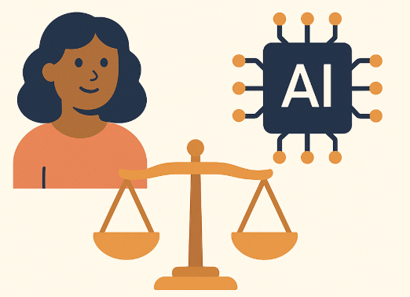
AI Bias and Fairness
Defining Fairness
Fairness in AI refers to the equitable treatment of individuals or groups by automated systems, ensuring that predictions or decisions are not systematically biased against any particular category (e.g., gender, race, age).

Slide 18
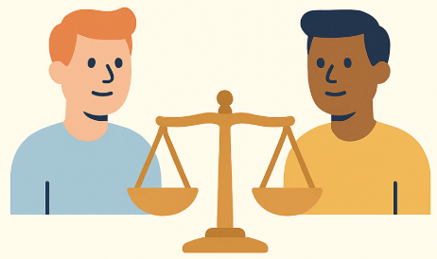
AI Bias and Fairness
Defining Fairness: Individual Fairness
Definition: “Similar individuals should receive similar outcomes.”
Idea: If two people are alike in relevant ways (qualifications, behavior, etc.), an AI system should treat them the same.
Example: In a loan approval system, two applicants with similar financial histories should receive similar credit decisions, regardless of irrelevant factors like race or gender.
Challenge: Requires a good similarity measure, which is often hard to define objectively.

Slide 19
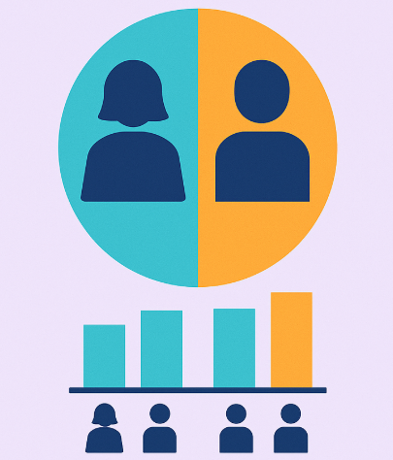
AI Bias and Fairness
Defining Fairness: Group Fairness
Definition: “Different groups should receive similar statistical outcomes.”
Focus: Ensures equity across demographic groups, like men vs women or majority vs minority.
Approach: Evaluate outcomes in aggregate, not per individual.

Slide 20
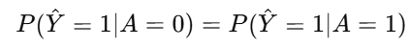
AI Bias and Fairness
Defining Fairness: Fairness Metrics (for Group Fairness)
Demographic Parity (Statistical Parity)
Goal: Positive outcomes are independent of protected attributes (e.g., gender, race).
Mathematical Form:
where Y is the prediction and A is a protected attribute.
Example: If 60% of male applicants are approved for a loan, demographic parity demands that 60% of female applicants also be approved.
Limitation: May reduce model accuracy and ignore individual qualifications.

Slide 21
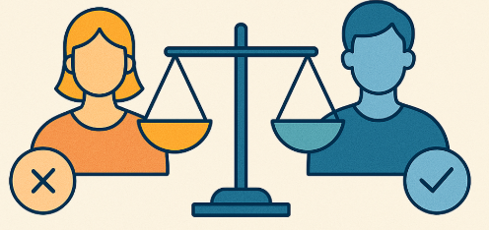
AI Bias and Fairness
Defining Fairness: Fairness Metrics (for Group Fairness)
Equalized Odds
Goal: The model’s error rates (true positives and false positives) should be equal across groups.
Mathematical Form:
Example: A disease diagnosis system should have equal sensitivity and specificity across both men and women.
Advantage: More nuanced than demographic parity; focuses on conditional fairness.

Slide 22
AI Bias and Fairness
Defining Fairness: Summary
Fairness Type | Focus | Key Metric | Strength | Limitation
Individual Fairness | Similar individuals | Distance-based rules | Personal-level accountability | Needs good similarity function
Group Fairness | Statistical group outcomes | Demographic Parity, Equalized Odds | Group-level equity | May ignore individual merit

Slide 23
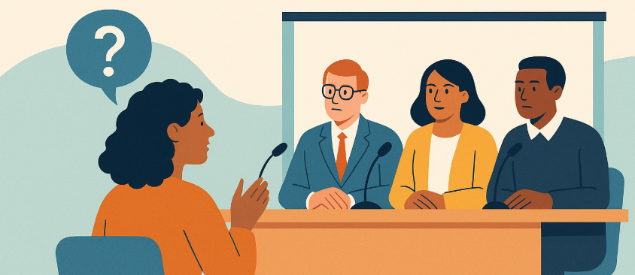
AI Bias and Fairness
Ethical Reflections
Fairness in AI isn't just technical—it's deeply ethical. It challenges us to ask not just what is fair, but who decides, who benefits, and what tradeoffs we are willing to accept.

Slide 24
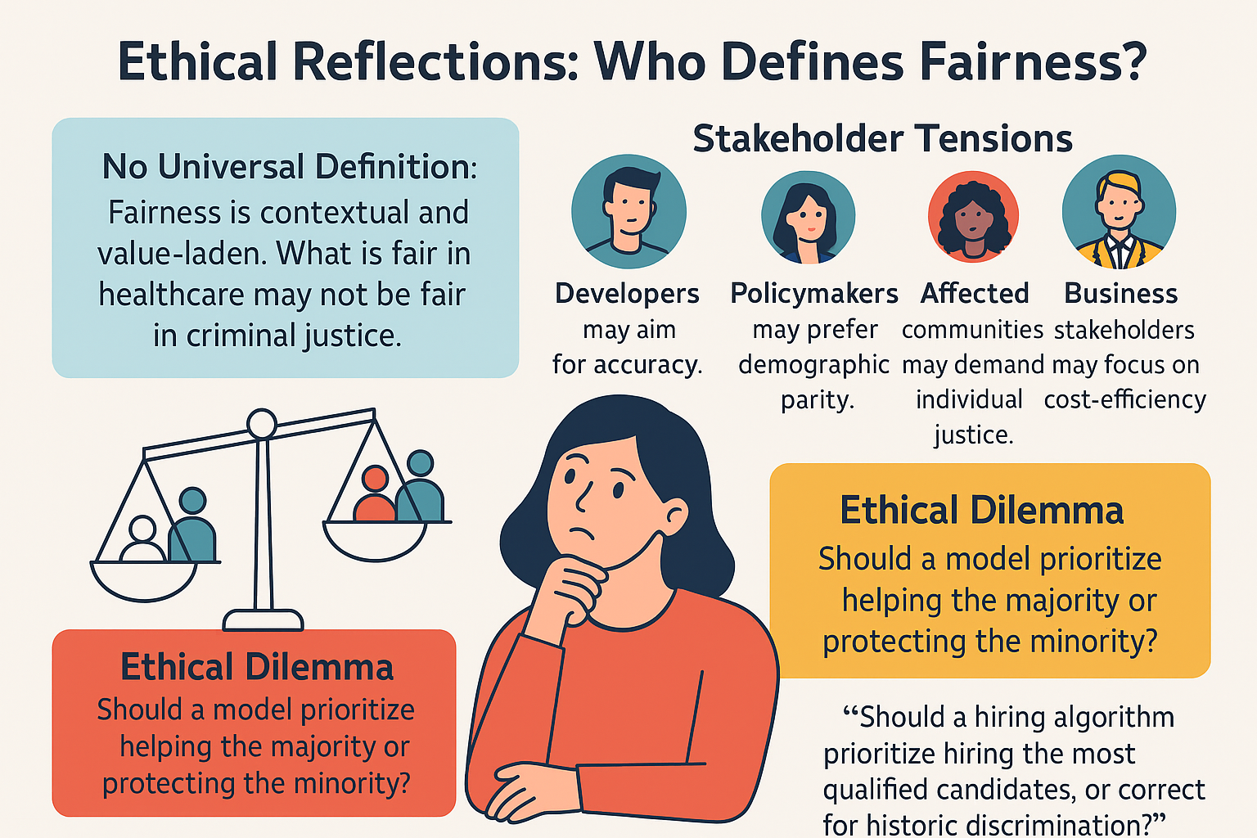
AI Bias and Fairness
Ethical Reflections: Who Defines Fairness?
No Universal Definition: Fairness is contextual and value-laden. What is fair in healthcare may not be fair in criminal justice.
Stakeholder Tensions:
Developers may aim for accuracy.
Policymakers may prefer demographic parity.
Affected communities may demand individual justice.
Business stakeholders may focus on cost-efficiency.
Ethical Dilemma: Should a model prioritize helping the majority or protecting the minority?
Reflection: “Should a hiring algorithm prioritize hiring the most qualified candidates, or correct for historic discrimination?”

Slide 25
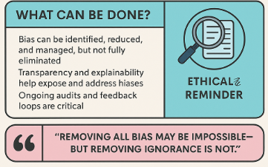
AI Bias and Fairness
Ethical Reflections: Can All Bias Be Removed?
Short Answer: No.
Why?
Bias is often inherent in historical data and human decisions.
Many biases are unconscious or emergent from correlations.
Some tradeoffs are mathematically incompatible (e.g., equalized odds vs demographic parity).
What Can Be Done?
Bias can be identified, reduced, and managed, but not fully eliminated.
Transparency and explainability help expose and address biases.
Ongoing audits and feedback loops are critical.
Ethical Reminder: “Removing all bias may be impossible—but removing ignorance is not.”

Slide 26
AI Bias and Fairness
Ethical Reflections: Tradeoffs Between Accuracy and Equity
Scenario | High Accuracy | High Fairness (Equity)
Loan approval (pure credit score) | Maximizes profit, may favor majority | May reduce profit to ensure inclusion
Healthcare risk models | Precise for majority populations | Needs group calibration to protect minorities
Hiring algorithm | Prioritizes experience/qualifications | Balances opportunity for underrepresented groups

Slide 27
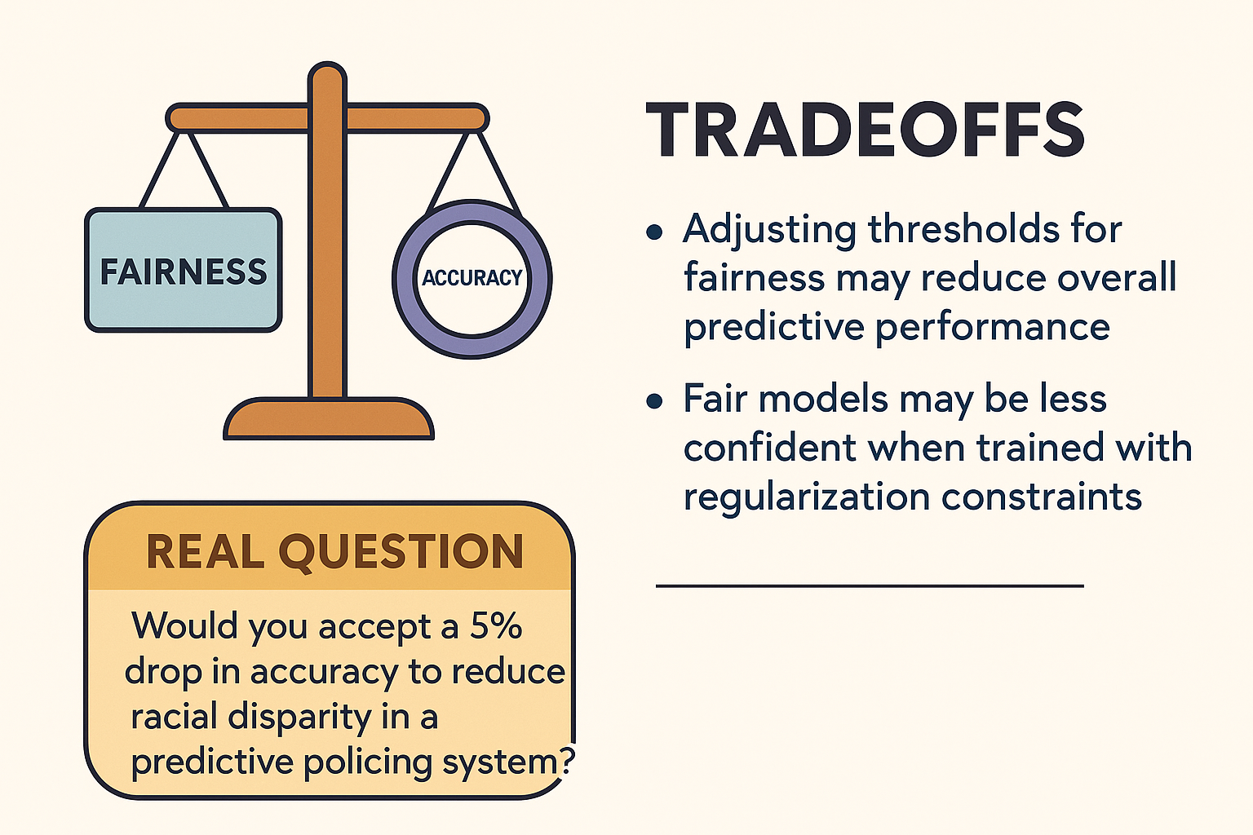
AI Bias and Fairness
Ethical Reflections
Tradeoff Examples:
Adjusting thresholds for fairness may reduce overall predictive performance.
Fair models may be less confident when trained with regularization constraints.
Real Question: Would you accept a 5% drop in accuracy to reduce racial disparity in a predictive policing system?

Slide 28
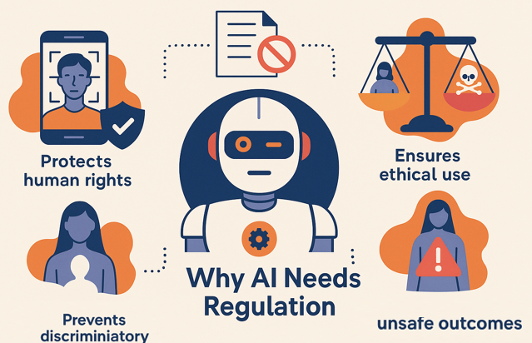
AI in Law & Regulations
Why AI Needs Regulation
AI, though powerful, can cause real-world harm if left unregulated. Regulation ensures ethical use, protects human rights, and prevents discriminatory or unsafe outcomes.

Slide 29
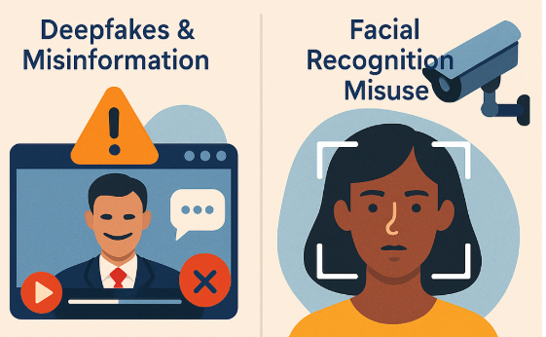
AI in Law & Regulations
Why AI Needs Regulation
Real-World Cases Highlighting the Need for Regulation:
Deepfakes & Misinformation
Problem: Hyper-realistic fake videos/images used in political propaganda, revenge porn, financial scams.
Impact: Undermines trust in media, poses national security threats.
Need for Regulation: Authenticity verification, consent laws, platform accountability.
Facial Recognition Misuse
Problem: Mass deployment by governments and private firms for public surveillance and commercial tracking.

Slide 30
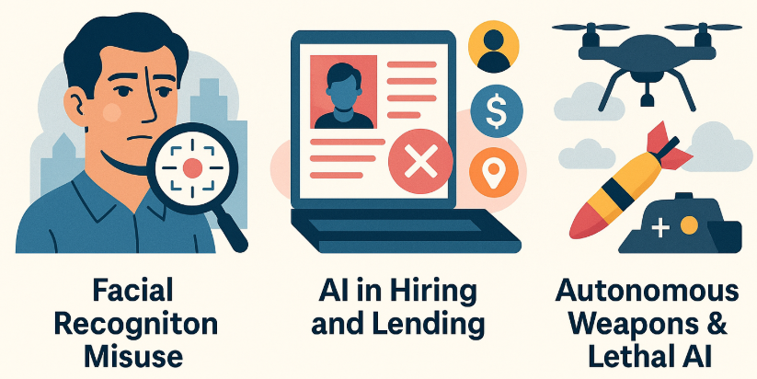
AI in Law & Regulations
Real-World Cases Highlighting the Need for Regulation:
In the UK, South Wales Police used facial recognition with high false positives.
In the US, Amazon’s Rekognition misidentified Congress members.
Impact: Racial profiling, wrongful arrests, invasion of privacy.
Need for Regulation: Transparency, opt-out rights, usage boundaries.
AI in Hiring and Lending: Algorithms have been found to replicate or amplify social inequities based on gender, race, ZIP code, etc.
Autonomous Weapons & Lethal AI: Use of AI in warfare without human oversight raises concerns about accountability, legality, and unintended escalations.

Slide 31
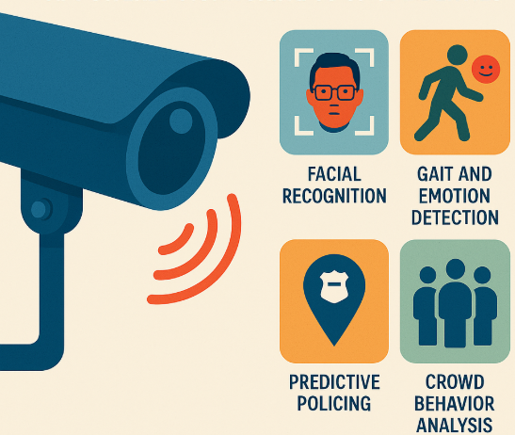
AI in Law & Regulations
Surveillance Concerns: AI-Powered Monitoring vs Civil Liberties
AI enhances surveillance power through:
Facial Recognition
Gait and Emotion Detection
Predictive Policing
Crowd Behavior Analysis

Slide 32
AI in Law & Regulations
Public Safety vs Privacy — The Core Debate
Argument For Surveillance | Argument Against Surveillance
Helps detect criminals and terrorists in real time | Invades privacy of ordinary citizens
Useful during pandemics or large public gatherings | Risk of abuse by authoritarian regimes
AI makes monitoring scalable and faster | High false positive rates can cause wrongful targeting
May deter crime with “eyes everywhere” effect | Chilling effect on free speech and expression

Slide 33
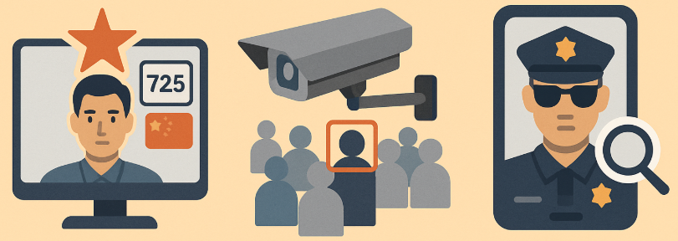
AI in Law & Regulations
Why AI Needs Regulation: Case Examples
China’s Social Credit System: Tracks behavior to assign social scores; impacts travel, loans, jobs.
India’s CCTV & AI analytics rollouts: AI used for facial recognition at public events and protests, raising questions on consent.
U.S. Police Use of Clearview AI: Mass image scraping without permission; legal and ethical backlash.

Slide 34
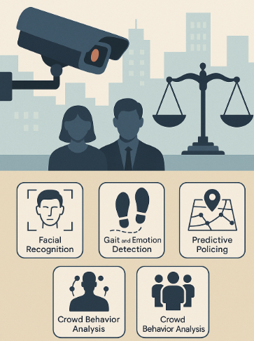
AI in Law & Regulations
Why AI Needs Regulation
Without clear boundaries, AI surveillance systems risk becoming tools of control, not protection. Regulations must ensure:
Proportionality
Oversight
Consent
Redressal mechanisms

Slide 35
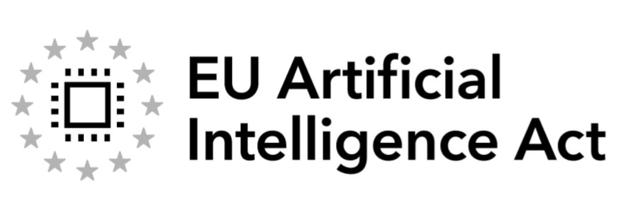
AI in Law & Regulations
EU AI Act Overview (2024)
World’s first comprehensive legal framework for regulating AI across the European Union. It adopts a risk-based approach to ensure safety, fundamental rights, and innovation.

Slide 36
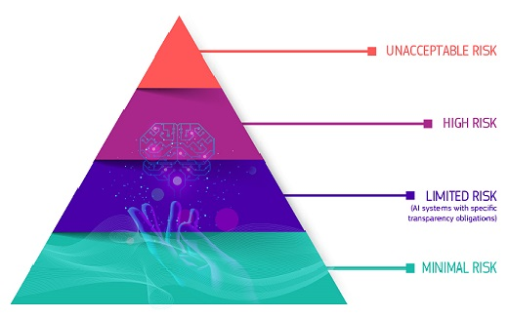
AI in Law & Regulations
EU AI Act Overview: Risk-Based Categories of AI Systems

Slide 37
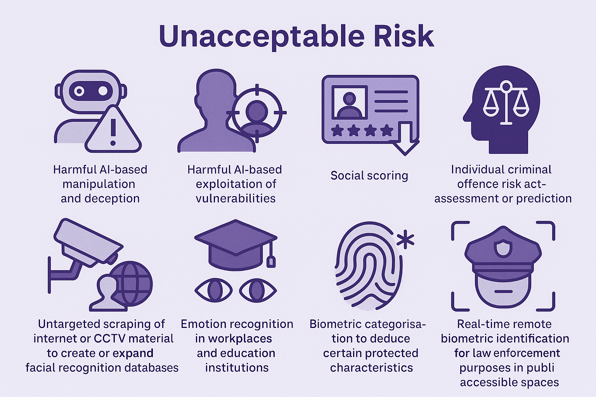
AI in Law & Regulations
Risk-Based Categories of AI Systems: Unacceptable risk
Harmful AI-based manipulation and deception
Harmful AI-based exploitation of vulnerabilities
social scoring
Individual criminal offence risk assessment or prediction
Untargeted scraping of the internet or CCTV material to create or expand facial recognition databases
Emotion recognition in workplaces and education institutions
Biometric categorization to deduce certain protected characteristics
Real-time remote biometric identification for law enforcement purposes in publicly accessible spaces

Slide 38
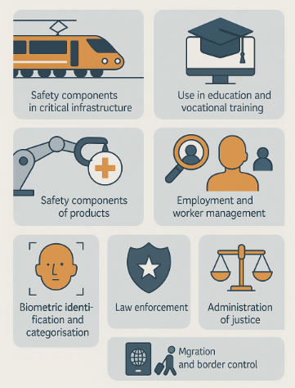
AI in Law & Regulations
Risk-Based Categories of AI Systems: High risk
AI safety components in critical infrastructures (e.g. transport), the failure of which could put the life and health of citizens at risk
AI solutions used in education institutions, that may determine the access to education and course of someone’s professional life (e.g. scoring of exams)
AI-based safety components of products (e.g. AI application in robot-assisted surgery)
AI tools for employment, management of workers and access to self-employment (e.g. CV-sorting software for recruitment)
Certain AI use-cases utilised to give access to essential private and public services (e.g. credit scoring denying citizens opportunity to obtain a loan)

Slide 39
AI in Law & Regulations
Risk-Based Categories of AI Systems: High risk
AI systems used for remote biometric identification, emotion recognition and biometric categorization (e.g AI system to retroactively identify a shoplifter)
AI use-cases in law enforcement that may interfere with people’s fundamental rights (e.g. evaluation of the reliability of evidence)
AI use-cases in migration, asylum and border control management (e.g. automated examination of visa applications)
AI solutions used in the administration of justice and democratic processes (e.g. AI solutions to prepare court rulings)

Slide 40
AI in Law & Regulations
EU AI Act Overview: Risk-Based Categories of AI Systems
Risk Level | Examples | Regulatory Status
Unacceptable Risk | Social scoring, real-time biometric ID in public | Banned
High Risk | Biometric ID, recruitment, education, law enforcement tools | Strict regulations
Limited Risk | Chatbots, deepfakes | Transparency obligations
Minimal Risk | AI in games, spam filters | No regulation needed

Slide 41
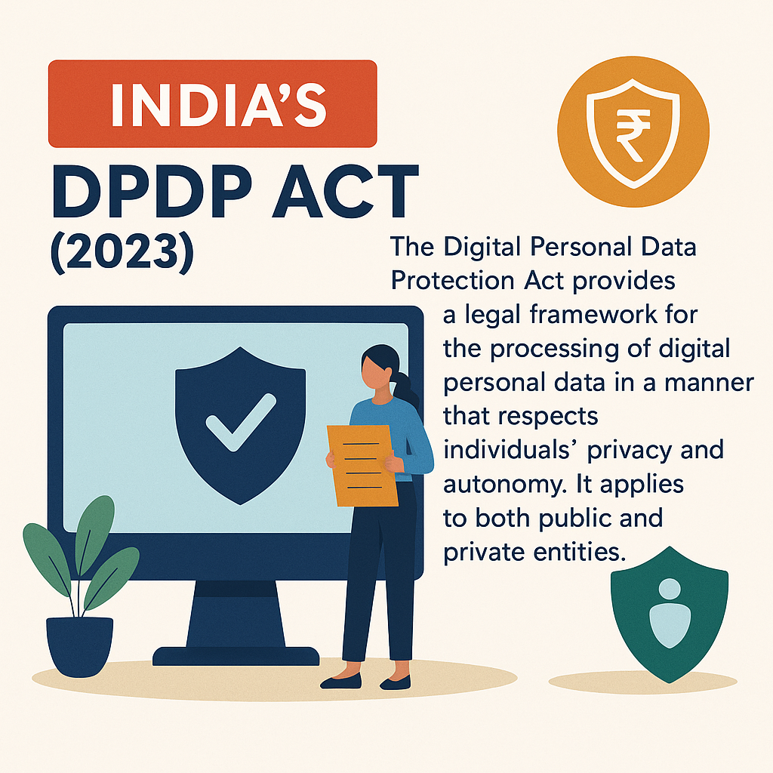
AI in Law & Regulations
India’s DPDP Act (2023)
The Digital Personal Data Protection Act provides a legal framework for the processing of digital personal data in a manner that respects individuals' privacy and autonomy. It applies to both public and private entities.

Slide 42
AI in Law & Regulations
India’s DPDP Act (2023)
Term | Meaning
Data Principal | The individual to whom the personal data relates.
Data Fiduciary | Any person, company, or government agency that determines how and why personal data is processed.
Consent Manager | An entity registered with the Data Protection Board, helping users manage and revoke consent for data use (similar to a centralized interface or dashboard).
Significant Data Fiduciary (SDF) | Fiduciaries handling large volumes of sensitive data; have additional obligations, such as audits and appointing Data Protection Officers (DPOs).

Slide 43
AI in Law & Regulations
India’s DPDP Act (2023): Rights of Data Principals
Right | Explanation
Right to Access Information | Know what personal data is being collected and processed.
Right to Correction | Request corrections or updates to inaccurate or outdated personal data.
Right to Erasure | Demand deletion of personal data when no longer needed or upon consent withdrawal.
Right to Grievance Redressal | File complaints with the Data Fiduciary or escalate to Data Protection Board.
Right to Nominate | Nominate another person to exercise rights in case of death or incapacity.

Slide 44
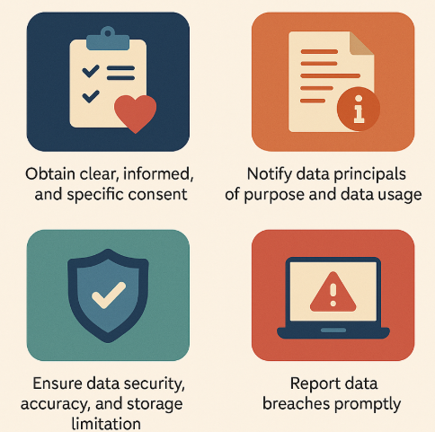
AI in Law & Regulations
India’s DPDP Act (2023): Obligations on Data Fiduciaries
Obtain clear, informed, and specific consent.
Notify data principals of purpose and data usage.
Ensure data security, accuracy, and storage limitation.
Report data breaches promptly.

Slide 45
AI in Law & Regulations
India’s DPDP Act (2023): Penalties & Enforcement
Violation | Penalty
Breach of personal data | Up to ₹250 crore
Failure to notify breach | Up to ₹200 crore
Failure to meet child-specific obligations | Up to ₹200 crore
Violation of other fiduciary obligations | Graded penalties based on severity

Slide 46
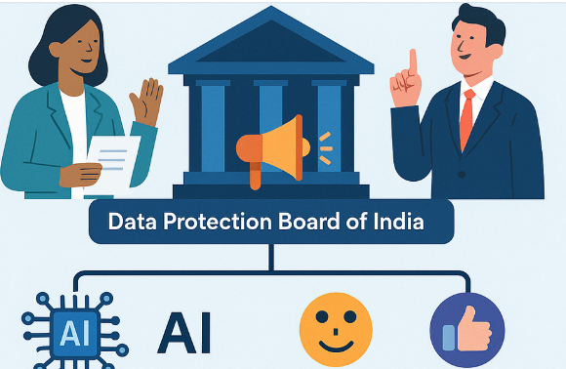
AI in Law & Regulations
India’s DPDP Act (2023): Penalties & Enforcement
Enforcement Body: Data Protection Board of India (DPBI)
Adjudicates violations
Has powers to summon, impose penalties, and enforce compliance
Relation to AI Regulation
AI systems using personal data (e.g., facial recognition, recommendation engines) must now:
Seek consent transparently.
Respect erasure and correction rights.
Follow data minimization and fairness principles.

Slide 47
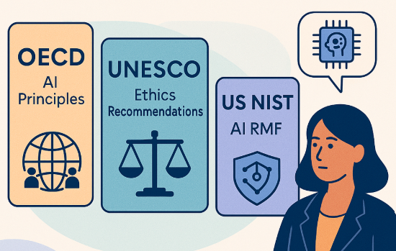
AI in Law & Regulations
Global AI Governance Trends
As AI systems increasingly influence economies, societies, and democratic processes, global AI governance frameworks have emerged to ensure ethical, safe, and inclusive development and deployment.

Slide 48
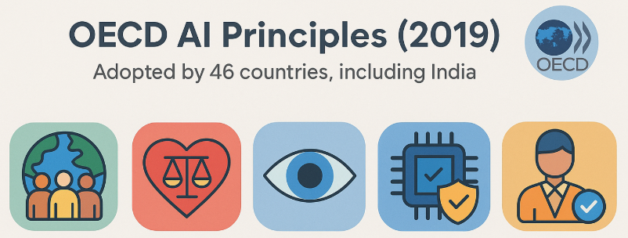
AI in Law & Regulations
Global AI Governance Trends: OECD AI Principles (2019)
Adopted by 46 countries, including India.
Five Core Principles:
Inclusive growth, sustainable development, and well-being: AI should benefit people and the planet.
Human-centered values and fairness: Respect for human rights, dignity, and diversity.
Transparency and explainability: AI decisions should be understandable and traceable.
Robustness, security, and safety: AI systems must function reliably and safely.
Accountability: People and organizations developing AI are responsible for its outcomes.
Use: Forms the foundation for national AI strategies (e.g., India’s NAI strategy, Canada’s AI policy).

Slide 49
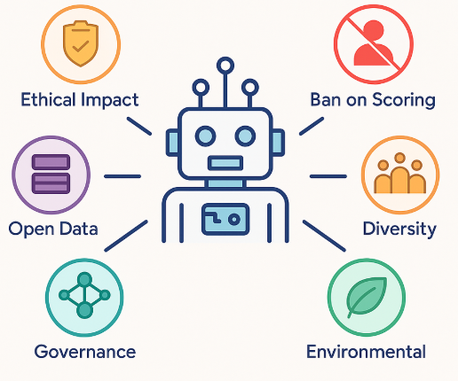
AI in Law & Regulations
Global AI Governance Trends: UNESCO AI Ethics Guidelines (2021)
First UN-level global standard on AI ethics. Adopted by 193 member states.
Key Highlights:
Ethical Impact Assessments (EIA):Countries should mandate ethical risk checks before deploying AI.
Ban on Social Scoring & Mass Surveillance: Supports restrictions on intrusive biometric systems.
Data Governance: Promotes open, inclusive, and non-discriminatory data sharing.
Environmental Considerations: Encourages energy-efficient AI to support climate goals.
Gender & Cultural Diversity: Promote inclusive datasets, especially for underrepresented communities.
Use: Influences education systems and AI curriculum reforms in many countries.

Slide 50
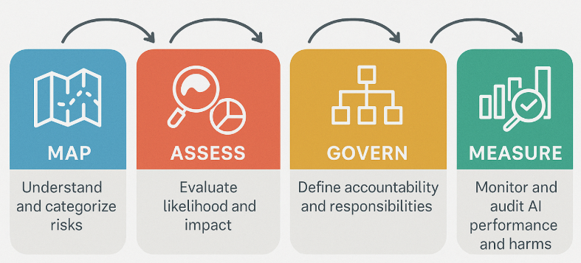
AI in Law & Regulations
Global AI Governance Trends: NIST AI Risk Management Framework (RMF) – USA (2023)
Led by the U.S. National Institute of Standards and Technology.
Framework Pillars:
Core Functions (MAP):
Map → Understand and categorize risks.
Assess → Evaluate likelihood and impact.
Govern → Define accountability and responsibilities.
Measure → Monitor and audit AI performance and harms.

Slide 51
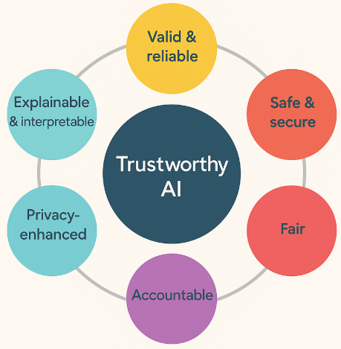
AI in Law & Regulations
Global AI Governance Trends: NIST AI Risk Management Framework (RMF) – USA (2023)
Characteristics of Trustworthy AI:
Valid and Reliable
Safe and Secure
Explainable and Interpretable
Privacy-enhanced
Fair (with Harm Mitigation)
Accountable and Transparent
Use: Supports industry self-governance, especially in financial services, healthcare, and government procurement.

Slide 52
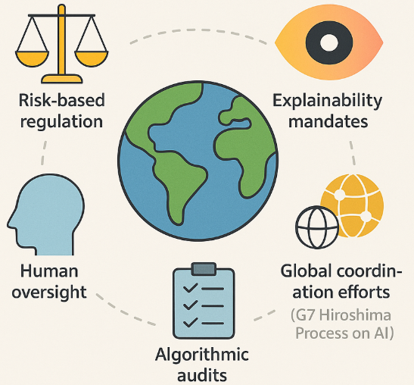
AI in Law & Regulations
Emerging Trends Across All Frameworks
Risk-based regulation
Human oversight
Explainability mandates
Algorithmic audits
Global coordination efforts (e.g., G7 Hiroshima Process on AI)

Slide 53
THANK YOU

